Slide 1
Impact Reporting
Name
Meeting Purpose
Location
Date
Notes:
Customize to your meeting.

Slide 2
Impact Reporting
Your work is important!
Someone cares about your work!
Part of your research work and time should be devoted to communications!
WHY are you doing the work?
WHO cares about the work?
WHAT is the IMPACT of your work?
(Adapted from Mike Harrington)
Notes:
ALL research is conducted with an eye towards increasing knowledge in a continuum to on-the-ground societal applications
While it may be fascinating to the individual, group or multistate project participants, ultimately someone else is PAYING for it and there should be some regular accountability and communications
This accountability could be in the form of granting agency reports, annual meeting synopsis, project summaries, NIMSS system updates, annual review productivity reports, responding to requests for information
Inherently, a distinct, short, lay-person synopsis will be created that will succinctly communicate the WHY?, WHO? and WHAT? of your work

Slide 3
Impact Reporting
Multistate projects must complete the SAES-422 Annual Report within 60 days of the annual meeting and submit to NIMSS
These reports include IMPACTS
Reports feed into the Multistate Research Fund (MRF) Impacts Program
Creates high-quality impact summaries and stories
Impact Statements used by:
Local AES, Regional Offices, ESCOP, APLU
National Research Support Projects (NRSPs)
Participating scientists
Communicators at participating institutions
USDA-NIFA for education at all levels and meetings with decision-makers in Washington, D.C.
Notes:
A multistate project is initially written with a methodical plan to reflect incremental progress annually and building up to a more comprehensive collection of milestones, accomplishments, outcomes, impacts
The SAES-422 Annual Reports should be short, to-the-point, and capture the collaborative and leveraging nature of the work an NOT be voluminous
Specific to the multistate project system
NIMSS, the National Information Management Support System (nimss.org ), provides a paperless environment to serve as the home for former/existing approved multistate projects (national), authorize meetings and serves as a repository for the annual meeting progress report
As the 5-year project progresses, there should be an increased number of concrete examples of accomplishments and, most importantly, IMPACTS, as a result of this collaborative, transformative work. It is perfectly acceptable to ‘project out’ potential applications and impacts of the work.
The national system of Agricultural Experiment Station (AES) directors has hired an Impact Writer to work with multistate projects at the end of a 5-year cycle to share the project’s work and its impacts, especially big picture impacts
The resulting “Impact Statement” is added to the overall multistate project impacts portfolio
They are distributed nationally and can then be used in multiple ways and on a variety of platforms to communicate the importance and impact of the work with many audiences

Slide 4
Impact Reporting
Multistate Research Fund Impacts Program
https://www.mrfimpacts.org/
National Impacts Database
https://landgrantimpacts.org/
Notes:
Impact Statements are distributed widely via direct email, social media, and other ways
There are two main libraries for completed Impact Statements
The Multistate Research Fund Impacts Program is THE location for all completed impact statements about multistate projects
The National Impacts Database has a broader purpose to capture stories from individual states across teaching, research and Extension. Multistate project Impact Statements are also housed here. This is accessible 24/7 and is accessed by institutions, communicators, NIFA, ESS leadership, regional associations and more.
NIMSS reports serve as the source for compiling Impact Statements. Completed Impact Statements are also stored here.

Slide 5
Outputs = Impacts
Reports, publications, patents
Data, findings, information
Workshops
Meetings
Number of persons who attended a meeting, workshop or enrolled in a program
These are outputs!!!
Notes:
Over many years as scientists and educators we collect “count” information
While very useful, these are OUTPUTS
We need to get to IMPACTS of the work as that is the key aspect of the relevancy and importance of the work

Slide 6
What is an Impact Statement?
BRIEF summary, in lay language, of the difference research and/or Extension activities have made or could make
Answers the questions: Why? Who Cares? So What?
Highlights the public value of your project/program
Explains why the project/program matters to specific stakeholders
Shows change(s) in:
Knowledge
Behavior
Social, economic, or environmental condition
Notes:
Impact statements are brief summaries of the differences made
An impact statement tells a story that connects the issue your work is addressing, the actions you took, your results/outputs, and your impacts
Impact statements should be easy to understand, so avoid jargon when discussing issue, action, and results
Your impacts are the changes in condition, economic value or efficiency, environmental quality or societal/individual well-being
The impacts could be: Adoption of technology, Creation of jobs, Reduced cost to the consumer, Increased profitability, Less pesticide use, Access to more nutritious food, Cleaner environment, Healthier communities and so on
While ACTUAL impacts are the pinnacle of Impact Reporting, the work may be at point in time where only educated estimates of potential impact or partial impact are able to be reported—this is fine!
Ultimately, impact statements answers the questions Why? Who Cares? So What?
The Who Cares? could be specific stakeholders, or the general public
Once you have written a good impact statement about your work, you can use it in many ways and easily repurpose it or tweak it for specific communications needs

Slide 7
Additional Resources
Multistate Research Impacts Program Workshop
https://www.mrfimpacts.org/impact-writing-training
Writing Extension Impact Statements
http://web.utk.edu/~aee/impactstatements.html
Impact Statements
http://www.ca.uky.edu/agpsd/impact.html
Impact Statements for Researchers
http://www.maes.msu.edu/intranet/Report_impact.html
Writing Effective Impact Statements: Who Cares? So What?
http://www.cals.vt.edu/communications/writingimpactstatements.html
Notes:
Resources are available for self-guided training and learning AND application to your activities
Several LGUs have created training and background materials that are available
What does your institution have to offer?
The ability to create and craft an Impact Statement is a learned skill, that can be continually refined
We’re not asking you to be perfect at it. Because reporting is a required part of your research/Extension work—and reporting matters—we’re asking you to take some time to do it as well as you can. You did the work, you know it best, so you should take the first stab at condensing it into a report. Other kinds of communicators can take over from there.
The ‘impact’ of learning and doing impact reporting will permeate all aspects of communicating your current and future work directly connected to future activities and program aspirations

Slide 8
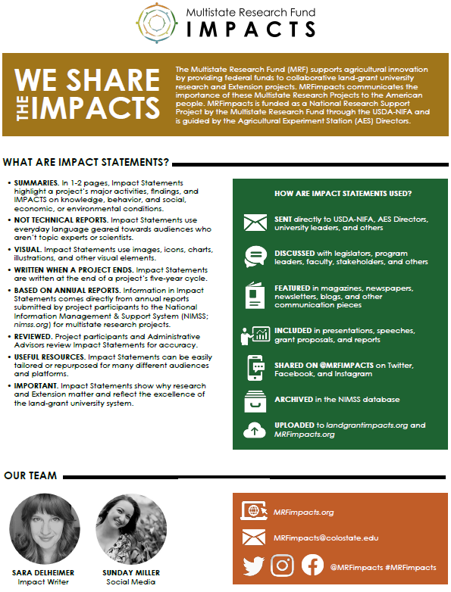
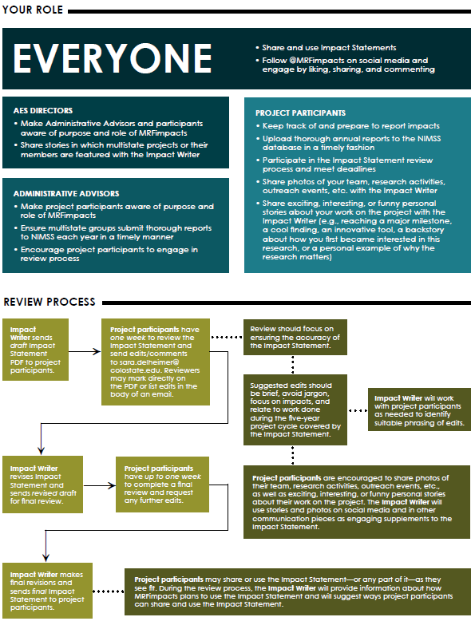
Impact Reporting
Notes:
Check out: MRFimpacts.org
GET THIS HANDOUT FOR YOUR MULTISTATE COMMITTEE PARTICIPANTS!!
Aspire to improve your communications based upon the high quality outcomes of your research and/or Extension efforts
This handout could/should reinforce the points in this presentation

Slide 9
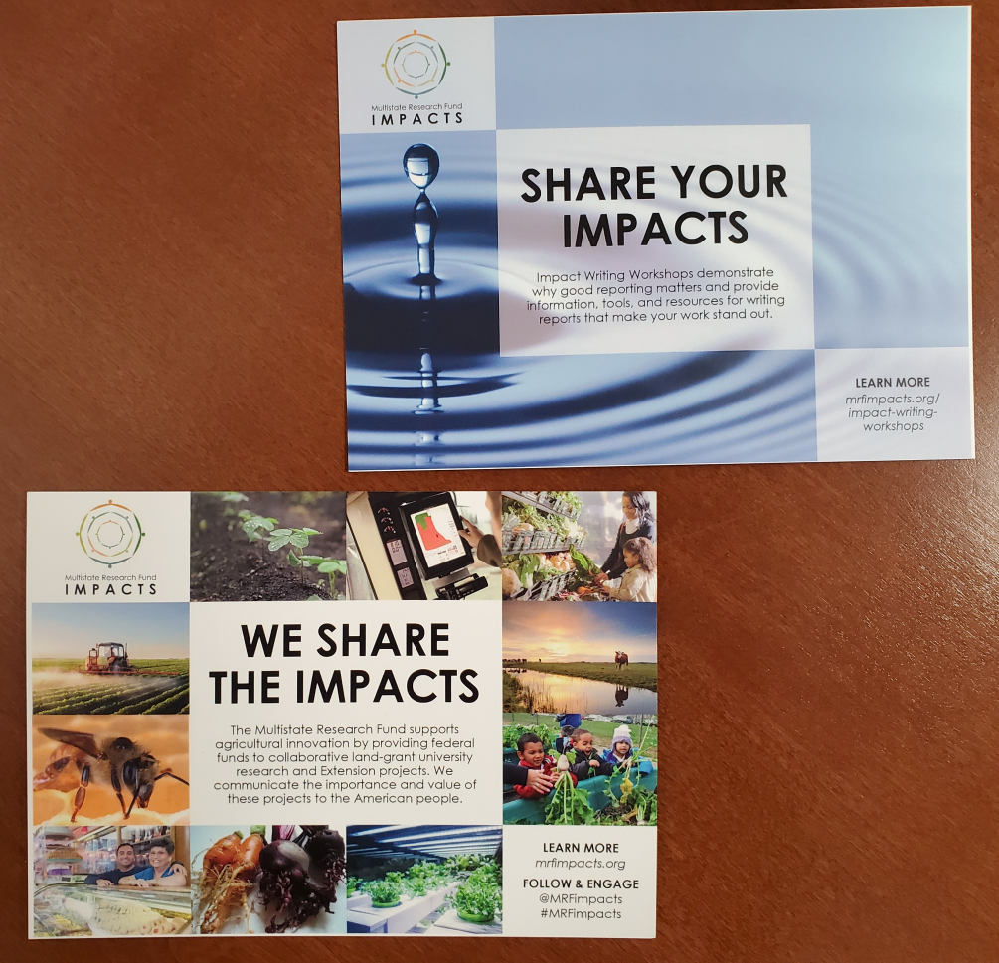
Impact Reporting
Notes:
Check out MRFimpacts.org
Aspire to improve your communications based upon the high quality outcomes of your research and/or Extension efforts
These cards are available from your regional association and could/should reinforce messages in this presentation

